Slide 1
Introduction to Metrics

Slide 2
Introduction
Measure:
It provides a quantitative indication of the extent, dimension, size and the capacity of a product.
Measurement:
It is defined as the act of evaluating a measure.
Metric:
It is a quantitative measure of the degree to which a system or its component possesses a given attribute.

Slide 3
A Quote on Measurement
“When you can measure what you are speaking about and express it in numbers, you know something about it; but when you cannot measure, when you cannot express it in numbers, your knowledge is of a meager and unsatisfactory kind; it may be the beginning of knowledge, but you have scarcely, in your thoughts, advanced to the stage of science.”
LORD WILLIAM KELVIN (1824 – 1907)

Slide 4
What are Software Metrics?
A software metric is a measure of software characteristics which are measurable or countable.
Software metrics are valuable for many reasons, including measuring software performance, planning work items, measuring productivity, and many other uses.

Slide 5
What are Metrics?
Software metrics are quantitative measures
They are a management tool
They offer insight into the effectiveness of the software process and the projects.
Basic quality and productivity data are collected
These data are analyzed, compared against past averages, and assessed
The goal is to determine whether quality and productivity improvements have occurred
The data can also be used to pinpoint problem areas
Remedies can then be developed and the software process can be improved

Slide 6
Uses of Measurement
Can be applied to the software process with the intent of improving it on a continuous basis
Can be used throughout a software project to assist in estimation, quality control, productivity assessment, and project control
Can be used to help assess the quality of software work products and to assist in tactical decision making as a project proceeds

Slide 7
What to be measured?
Characteristics of the software product:
Software size and complexity
Software reliability and quality
Functionalities
Performance
Characteristics of the software project:
Number of software developer
Staffing pattern over the life cycle of software
Cost and schedule
Productivity
Characteristics of software process:
Methods, tools, and techniques used for software development
Efficiency of detection of fault

Slide 8
Reasons to Measure
To characterize in order to
Gain an understanding of processes, products, resources, and environments
Establish baselines for comparisons with future assessments
To evaluate in order to
Determine status with respect to plans
To improve in order to
Identify roadblocks, root causes, inefficiencies, and other opportunities for improving product quality and process performance

Slide 9
Role of Metrics in the Process Domain
Process metrics are collected across all projects and over long periods of time
They are used for making strategic decisions
The intent is to provide a set of process indicators that lead to long-term software process improvement
The only way to know how/where to improve any process is to
Measure specific attributes of the process
Develop a set of meaningful metrics based on these attributes
Use the metrics to provide indicators that will lead to a strategy for improvement

Slide 10
Metrics in the Process Domain.......
We measure the effectiveness of a process by deriving a set of metrics based on outcomes of the process such as
Errors uncovered before release of the software
Defects delivered to and reported by the end users
Work products delivered
Human effort expended
Calendar time expended
Conformance to the schedule
Time and effort to complete each generic activity

Slide 11
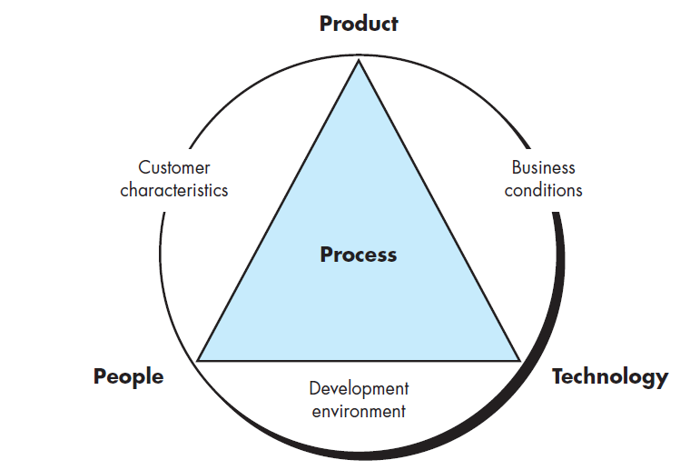
Determinants for software quality an organizational effectiveness.

Slide 12
Etiquette of Process Metrics
Use common sense and organizational sensitivity when interpreting metrics data
Provide regular feedback to the individuals and teams who collect measures and metrics
Don’t use metrics to evaluate individuals
Work with practitioners and teams to set clear goals and metrics that will be used to achieve them
Never use metrics to threaten individuals or teams
Metrics data that indicate a problem should not be considered “negative”
Such data are merely an indicator for process improvement
Don’t obsess on a single metric to the exclusion of other important metrics

Slide 13
Role of Metrics in the Project Domain
Project metrics enable a software project manager to
Assess the status of an ongoing project
Track potential risks
Uncover problem areas before their status becomes critical
Adjust work flow or tasks
Evaluate the project team’s ability to control quality of software work products
Many of the same metrics are used in both the process and project domain
Project metrics are used for making tactical decisions
They are used to adapt project workflow and technical activities

Slide 14
Use of Project Metrics
The first application of project metrics occurs during estimation
Metrics from past projects are used as a basis for estimating time and effort
As a project proceeds, the amount of time and effort expended are compared to original estimates
As technical work commences, other project metrics become important
Production rates are measured (represented in terms of models created, review hours, function points, and delivered source lines of code)
Error uncovered during each generic framework activity (i.e, communication, planning, modeling, construction, deployment) are measured

Slide 15
Use of Project Metrics......
Project metrics are used to
Minimize the development schedule by making the adjustments necessary to avoid delays and mitigate potential problems and risks
Assess product quality on an ongoing basis and, when necessary, to modify the technical approach to improve quality
In summary
As quality improves, defects are minimized
As defects go down, the amount of rework required during the project is also reduced
As rework goes down, the overall project cost is reduced

Slide 16
Categories of Software Measurement
Two categories of software measurement
Direct measures of the
Software process (cost, effort, etc.)
Software product (lines of code produced, execution speed, defects reported over time, etc.)
Indirect measures of the
Software product (functionality, quality, complexity, efficiency, reliability, maintainability, etc.)

Slide 17
Size-oriented Metrics
Derived by normalizing quality and/or productivity measures by considering the size of the software produced
Thousand lines of code (KLOC) are often chosen as the normalization value
Based on the LOC/KLOC count of software, many other metrics can be computed:
Errors/KLOC.
$/ KLOC.
Defects/KLOC.
Pages of documentation/KLOC.
You can also compute other things like,
Errors/PM.
Productivity = KLOC/PM (effort is measured in person-months).
$/ Page of documentation.

Slide 18
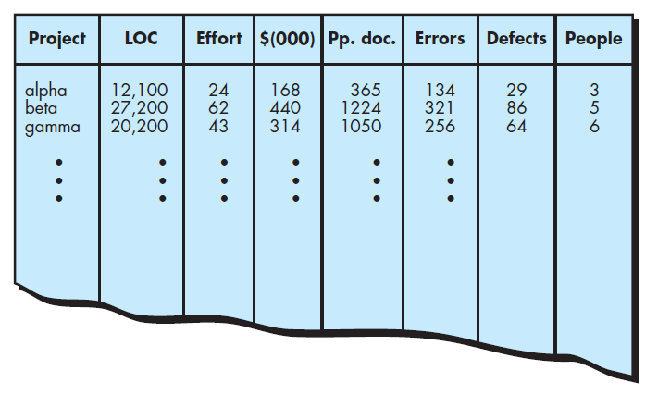
Size-oriented Metrics

Slide 19
Size-oriented Metrics.....
Size-oriented metrics are not universally accepted as the best way to measure the software process
Opponents argue that KLOC measurements
Are dependent on the programming language
Penalize well-designed but short programs
Require a level of detail that may be difficult to achieve

Slide 20
Function-Based Metrics
In 1977, A. J. Albrecht of IBM developed a method of software metrics based on the functionality of the software delivered by an application as a normalization value.
He called it the Function Points (FPs).
They are derived using an empirical relationship based on direct measures of software’s information domain and assessments of software complexity.
FPs try to quantify the functionality of the system, i.e., what the system performs.
This is taken as the method of measurement as FPs cannot be measured directly.
FP is not a single characteristic but is a combination of several software features/characteristics.

Slide 21
Function-Based Metrics
The effort required to develop the project depends on what the software does.
FP is programming language independent.
FP method is used for data processing systems, business systems like information systems.

Slide 22
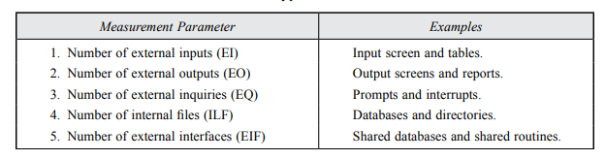
Function Point Computation
FPs of an application is found out by counting the number and types of functions used in the applications.
Various functions used in an application can be put under five types as shown in Table:
The 5 parameters mentioned are also known as information domain characteristics.
All these parameters are then individually assessed for complexity.

Slide 23
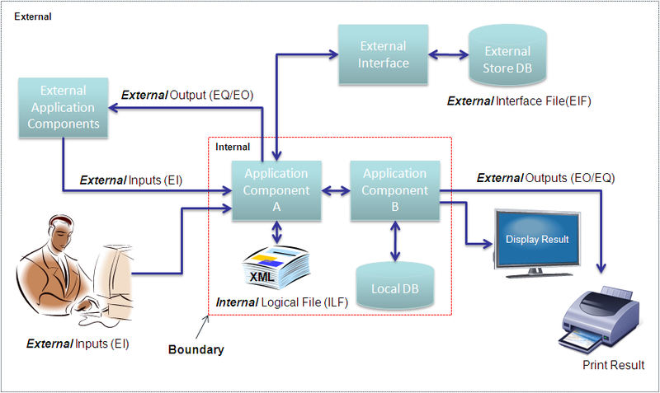
FPA components

Slide 24
Function Point Computation…..
The calculation begins with the counting of the five function types of a project or application:
These 5 function types are then ranked according to their complexity: Low, Average or High, using a set of prescriptive standards.
These counts are then multiplied with the corresponding weights(complexity) values and the values are added up to determine the UFP (Unadjusted Function Point) or count total of the subsystem.

Slide 25
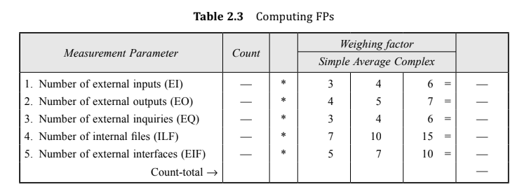
Function Point Computation…..
Organizations that use FP methods, develop criteria for determining whether a particular entry is Low, Average or High.
Nonetheless, the determination of complexity is somewhat subjective.

Slide 26
Function Point Computation…..
complexity adjustment value/ factor
The last step involves assessing the environment and processing complexity of the project or application as a whole.
In this step, the impact of 14 general system characteristics is rated on a scale from 0 to 5 in terms of their likely effect on the project or application.

Slide 27
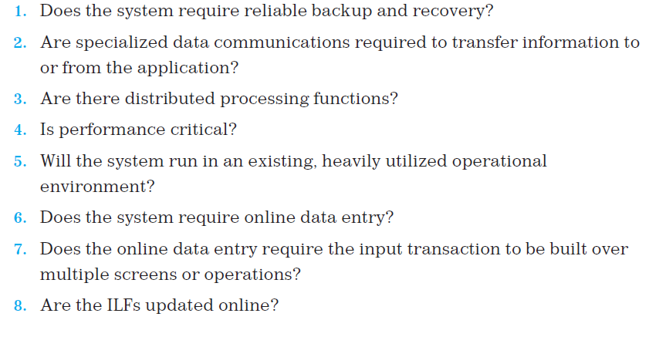
complexity adjustment value/ factor
complexity adjustment value/ factor are calculated based on responses to the following questions

Slide 28
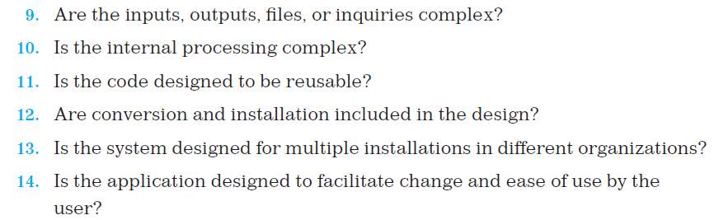
Computing Value Adjustment Factor….

Slide 29
complexity adjustment value/ factor
Each of these questions is answered using an ordinal scale that ranges from 0 (not important or applicable) to 5 (absolutely essential).
0 – No influence
1 – Incidental
2 – Moderate
3 – Average
4 – Significant
5 - Essential
The constant values in FP Equation and the weighting factors that are applied to information domain counts are determined empirically.

Slide 30
Function Point Computation…..
The Function Point (FP) is thus calculated with the following formula
FP = Count-total * [0.65 + 0.01 * ∑(Fi ) ]
= Count-total * CAF
where Count-total is obtained from the table 2.3.
CAF = [0.65 + 0.01 * ∑(Fi )]
∑(Fi ) is the sum of all 14 questionnaires and show the complexity adjustment value/ factor-CAF (where i ranges from 1 to 14).

Slide 31
Function Point Computation…..
∑(Fi ) ranges from 0 to 70,
i.e., 0 <= ∑(Fi) <=70 and CAF ranges from 0.65 to 1.35
because
(a) When ∑(Fi) = 0 then CAF = 0.65
(b) When ∑(Fi) = 70 then CAF = 0.65 + (0.01 * 70) = 0.65 + 0.7 = 1.35

Slide 32
Function Point Computation…..
Based on the FP measure of software many other metrics can be computed:
(a) Errors/FP
(b) $/FP.
(c) Defects/FP
(d) Pages of documentation/FP
(e) Errors/PM.
(f) Productivity = FP/PM (effort is measured in person-months).
(g) $/Page of Documentation.

Slide 33
Example
Given the following values, compute function point and productivity when all complexity adjustment factor (CAF) and weighting factors are average.
User Input = 50
User Output = 40
User Inquiries = 35
User Files = 6
External Interface = 4
Effort = 36.9 p-m

Slide 34
Example…….
Solution:
Step-1:
As complexity adjustment factor is average (given in question), hence, scale = 3.
∑(Fi ) = 14 * 3 = 42
Step-2:
CAF = [0.65 + 0.01 * ∑(Fi )]
CAF = 0.65 + ( 0.01 * 42 ) = 1.07

Slide 35
Example…….
Step-3:
As weighting factors are also average (given in question) hence we will multiply each individual function point to corresponding values in function point table 2.3
Count Total = (50*4) + (40*5) + (35*4) + (6*10) + (4*7)
= 628
Step-4:
FP = Count-total * [0.65 + 0.01 * ∑(Fi )]
= Count-total * CAF
= 628 * 1.07 = 671.96

Slide 36
Example…….
Productivity = FP/ Effort
= 671.96/36.9
= 18.21

Slide 37
Function Point Controversy
Like the KLOC measure, function point use also has proponents and opponents
Proponents claim that
FP is programming language independent
FP is based on data that are more likely to be known in the early stages of a project, making it more attractive as an estimation approach
Opponents claim that
FP requires some “sleight of hand” because the computation is based on subjective data.
FPA has been criticized as not being universally applicable to all types of software.
For example, FPA doesn’t capture all functional characteristics of real-time software

Slide 38
Object-oriented Metrics
If you are planning to develop a software through an object oriented approach, then you can go for object oriented metrics.
Conventional metrics are not provide granularity for schedule and effort estimation for incremental or evolutionary projects.

Slide 39
Object-oriented Metrics…..
Lorenz and Kidd [Lor94] suggest the following set of metrics for OO projects:
Number of scenario scripts (i.e., use cases)
detailed sequence of steps that describes the interaction between the user and the application.
Each script is organized into triplets of the form
{ initiator, action, participant }
This number is directly related to the size of an application and to the number of test cases required to test the system

Slide 40
Object-oriented Metrics
Number of key classes (the highly independent components)
Key classes are defined early in object-oriented analysis and are central to the problem domain
This number indicates the amount of effort required to develop the software
It also indicates the potential amount of reuse to be applied during development
Number of support classes
Support classes are required to implement the system but are not immediately related to the problem domain (e.g., user interface, database, computation)

Slide 41
Object-oriented Metrics...
Average number of support classes per key class
Key classes are identified early in a project (e.g., at requirements analysis)
Estimation of the number of support classes can be made from the number of key classes
GUI applications have between two and three times more support classes as key classes
Non-GUI applications have between one and two times more support classes as key classes
Number of subsystems
A subsystem is an aggregation of classes that support a function that is visible to the end user of a system

Slide 42
Use Case-Oriented Metrics
Describes customer-level or business domain requirements that imply software features and functions.
Use case is defined early in the software process, allowing it to be used for estimation before significant modeling and construction activities are initiated.
Independent of programming language.
The number of use cases is directly proportional to the size of the application in LOC and to the number of test cases that will have to be designed to fully exercise the application.

Slide 43
Use Case-Oriented Metrics…
Use cases can be created at vastly different levels of abstraction, there is no standard “size” for a use case.
use-case points (UCPs) as a mechanism for estimating project effort and other characteristics.
The UCP is a function of the number of actors and transactions implied by the use-case models.

Slide 44
Metrics for Software Quality
You can use measurement to assess the quality of the requirements and design models, the source code, and the test cases that have been created as the software is engineered.
A project manager must also evaluate quality as the project progresses.
Private metrics collected by individual software engineers are combined to provide project-level results.
Although there are many measures of software quality, correctness, maintainability, integrity, and usability provide useful indicators for the project team.

Slide 45
Metrics for Software Quality…..
Correctness
This is the number of defects per KLOC, where a defect is a verified lack of conformance to requirements
Defects are those problems reported by a program user after the program is released for general use
Maintainability
This describes the ease with which a program can be corrected if an error is found, adapted if the environment changes, or enhanced if the customer has changed requirements
Mean time to change (MTTC) : the time to analyze, design, implement, test, and distribute a change to all users
Maintainable programs on average have a lower MTTC

Slide 46
Metrics for Software Quality…..
integrity
measures system’s ability to withstand attacks on its security
To measure integrity, two additional attributes must be defined:
threat
security.
Threat is the probability that an attack of a specific type will occur within a given time.
Security is the probability that the attack of a specific type will be repelled.

Slide 47
Metrics for Software Quality…..
The integrity of a system can then be defined as:
Integrity = ∑ [1 – (threat * (1 – security))]
For example, if threat (the probability that an attack will occur) is 0.25 and security (the likelihood of repelling an attack) is 0.95, the integrity of the system is 0.99 (very high).
Usability.
Usability is an attempt to quantify ease of use and can be measured in terms of the characteristics

Slide 48
Arguments for Software Metrics
Most software developers do not measure, and most have little desire to begin
Establishing a successful company-wide software metrics program can be a multi-year effort
But if we do not measure, there is no real way of determining whether we are improving
Measurement is used to establish a process baseline from which improvements can be assessed
Software metrics help people to develop better project estimates, produce higher-quality systems, and get products out the door on time

Slide 49
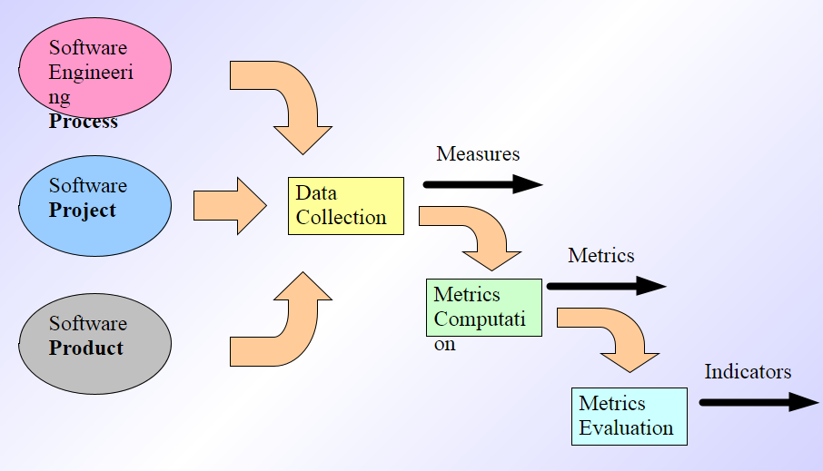
Software Metrics Baseline Process

Slide 50
Establishing a Metrics Baseline
By establishing a metrics baseline, benefits can be obtained at the software process, product, and project levels
The same metrics can serve many masters
The baseline consists of data collected from past projects
Baseline data must have the following attributes
Data must be reasonably accurate (guesses should be avoided)
Data should be collected for as many projects as possible
Measures must be consistent (e.g., a line of code must be interpreted consistently across all projects)
Past applications should be similar to the work that is to be estimated
After data is collected and metrics are computed, the metrics should be evaluated and applied during estimation, technical work, project control, and process improvement

